Slide 1
Software
Various programs used to operate computers and related devices.
It is a collection of instruction that enable the user to interact with a computer, its hardware, or perform tasks.
Computer software includes computer programs, libraries and related non-executable data, such as online documentation or digital medias.
Software is a variable part of a computer; whereas hardware is the invariable part.

Slide 2
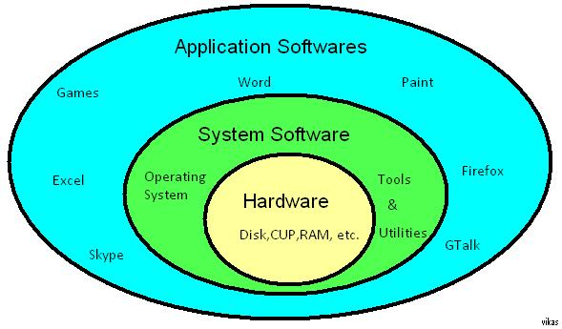
Software

Slide 3
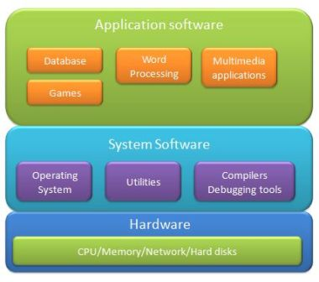
Software Types

Slide 4
System Software
It is a set of instructions that serves primarily as an intermediary between computer hardware and application programs.
It provides important self-regulatory functions for computer systems.
It can be directly manipulated by knowledgeable users.
System programming is either the creation or maintenance of system software.
It can be grouped into two functional categories: System Control Program and System Support Program.

Slide 5
System Control Program
It controls the use of the hardware, software and data resources.
The main system program is the Operating System.
OS supervise the overall operation of the computer, including monitoring the computer’s status & scheduling operations.
It allocates CPU time and main memory.
It is the interface between the user and the hardware.
This interface hides the hardware complexity of the hardware.

Slide 6
Services Provided by the OS
Process Management
Time Sharing
Virtual Memory
Multiprocessing
Fault processing
GUI

Slide 7
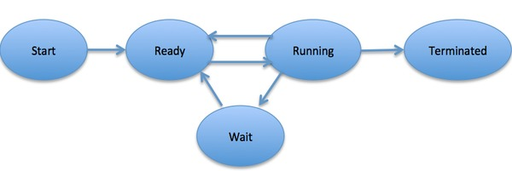
Process Management
A process is basically a program in execution. The execution of a process must progress in a sequential fashion.

Slide 8
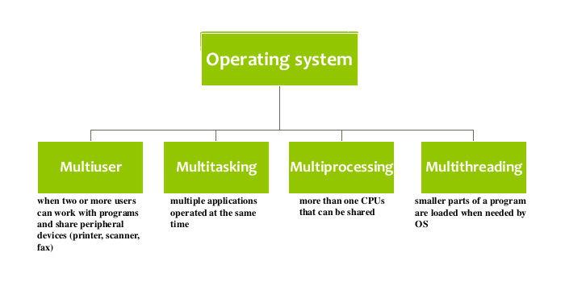
Process Management

Slide 9
Multiprogramming
In a multiprogramming system there are one or more programs loaded in main memory which are ready to execute.
Only one program at a time is able to get the CPU for executing its instructions (i.e., there is at most one process running on the system) while all the others are waiting their turn.
The main idea of multiprogramming is to maximize the use of CPU time.
The ultimate goal of multiprogramming is to keep the CPU busy as long as there are processes ready to execute.

Slide 10
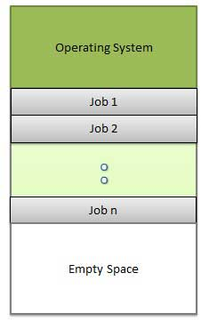
Multiprogramming

Slide 11
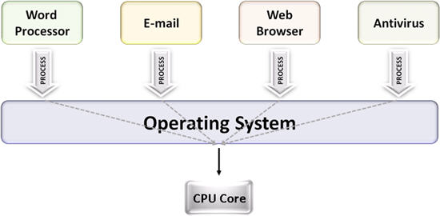
Multitasking
Both multiprogramming and multitasking operating systems are (CPU) time sharing systems.
Multitasking has the same meaning of multiprogramming but in a more general sense, as it refers to having multiple (programs, processes, tasks, threads) running at the same time.

Slide 12
Multiprocessing
Multiprocessing sometimes refers to executing multiple processes (programs) at the same time.
Multiprocessing refers to the hardware (i.e., the CPU units) rather than the software (i.e., running processes).
If the underlying hardware provides more than one processor then that is multiprocessing.
Several variations on the basic scheme exist, e.g., multiple cores on one die or multiple dies in one package or multiple packages in one system.

Slide 13
Multithreading
Multithreading is an execution model that allows a single process to have multiple code segments (i.e., threads) run concurrently within the “context” of that process.

Slide 14
Virtual Memory
A computer can address more memory than the amount physically installed on the system.
This extra memory is actually called virtual memory and it is a section of a hard disk that's set up to emulate the computer's RAM.
The main visible advantage of this scheme is that programs can be larger than physical memory.
Virtual memory divides an application program into fixed-length portions called pages.

Slide 15
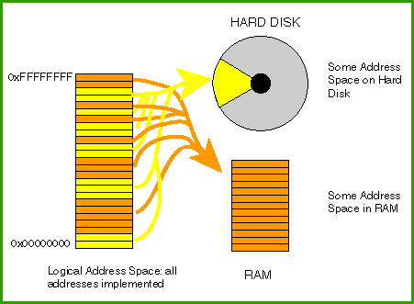
Virtual Memory

Slide 16
Types of OS
Your next assignment : due on Tuesday
Class presentation
Group of 4

Slide 17
System Support Program
It supports the operations, management and users of computer system by providing variety of services.
E.g. Security monitors & system performance monitors.

Slide 18
Application Software
Application software is a program or group of programs designed for end users.
It is designed to perform a group of coordinated functions, tasks, or activities for the benefit of the user.
It includes Proprietary application software and Off-the-Shelf application software.

Slide 19
Proprietary Application Software
It addresses a specific or unique business need of a company.
It may be developed ‘in-house’ or maybe commissioned from a software vendor.
Specific software programs developed for a particular company by a vendor are called Contract Software.

Slide 20
Off-the-Shelf
It can be purchased, leased, or rented from vendor that develops program.
It maybe a ‘Standard Package’ or customizable.

Slide 21
Personal Application Software
Spreadsheets (cells, macros)
Data Management
Word Processing (WYSIWYG)
Desktop Publishing
Graphics (Presentation & Analysis)
CAD/CAM/CIM
Multimedia
Communications
Speech Recognition
Groupware

Slide 22
Groupware
It is a product that facilitates communication, coordination and collaboration among people.
IBM’s Lotus Notes/Domino
Programs that enable real time collaboration are called synchronous groupware.
Groupware services can include the sharing of calendars, collective writing, e-mail handling, shared database access, electronic meetings with each person able to see and display information to others, and other activities.

Slide 23
Software Suites
These are collection of application software that includes some or all functions of package software.
MS-office, Lotus Smartsuite, Novell Perfect office

Slide 24
Software Issues
Evaluation and Selection
Licensing
Upgrades

